Slide 1



PropheTech
Cloud Era
Business Continuity ◇ 资产流转
Cross-platform Disaster Recovery (DR), Migration Services

Slide 2





混合架构的深度解决方案
Business Continuity 安全护航
资产流转 自主掌控
Hybrid Disaster Recovery
Cloud Migration
HybridDR
HyperMotion
Patented DR Solution
实现跨任意平台、秒级恢复、业务级别容灾，保障企业系统高可用、业务连续性
Live Migration
无损生产系统、业务不中断、高效快速实现任意平台交互迁移，助力企业自由灵活选择云资源

Slide 3









Before PropheTech
Production Servers
Traditional Architecture
Hybrid Cloud Architecture
Physical servers
Virtualization Architecture
Private Cloud
Public Cloud
Linux
Windows
Backup software
Backup server
Backup software
Backup server
Backup?
Disaster Recovery?
Backup?
Disaster Recovery?
Veritas, CommVault, EISOO, info2soft
Veeam

Slide 4





After PropheTech
Production Servers
Traditional Architecture
Hybrid Cloud Architecture
Physical servers
Virtualization Architecture
Private Cloud
Public Cloud
Linux
Windows
Prophet Hybrid Disaster Recovery Management Platform
Protection
Backup
Recovery(DR)
Live Migration
Develop / Test
Analysis
Immersive Training

Slide 5
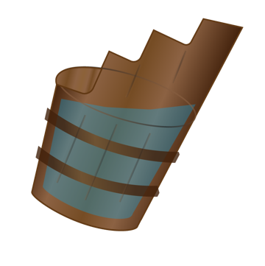





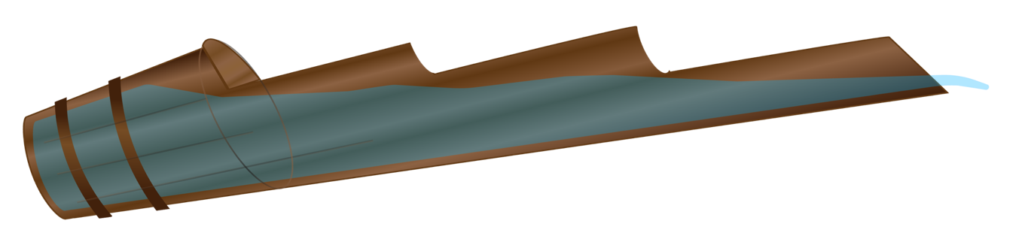





Nowadays
Cloud Computing Era
Enterprise
Live | Disaster Recovery | Backup
Enterprise Hybrid Cloud Environments
Protection+Fast Recovery
(Across platforms)
Virtual assets Transfer
Threshold
high cost
Operation challenges
Fulcrum
!
!
Threshold
Cost reduction 80%
One-click operation
90s Recovery
Cross-platform
Lower fulcrum
降低支点(门槛)让
长板足够长，延伸覆盖更大的市场

Slide 6
What’New?
The core technology development and applications
云计算时代 细分领域科技突破
大科技革新、小技术创新
技术创新是拿来用而不是看
契合需求，创新才有价值

Slide 7




Core Technology ◇ Exclusive Innovation
Syst.
App.
Data
Block-level protection
智能适配
Decoupling Storage
HyperGate
中国首家自主研发
Block-level protection
Supports P / V / C / C +
Exclusive Patented Technology
各种架构智能适配
Exclusive Patented Technology
Relieve Software and Hardware binding
Exclusive patented technology
Relieve Software and Hardware binding
Our Achievements
Compatible with any Cloud Platforms
Free choice of cloud resources
Fully utilize of cloud resources
Our solutions
Business-class Recovery in seconds
（Prerequisite）
Any to Any
Cross-platform Cross-architecture
Compatible with any storage hardware
Optimize hardware assets investment
China: Datasure (OEM FalconStor)
Overseas: FalconStor
(Cloud platforms are not supported)
China: None
Overseas: CloudEndure
(Same results, unknown technology)
China: None
Overseas: None
China: None
Overseas: None
Our Competitors

Slide 8
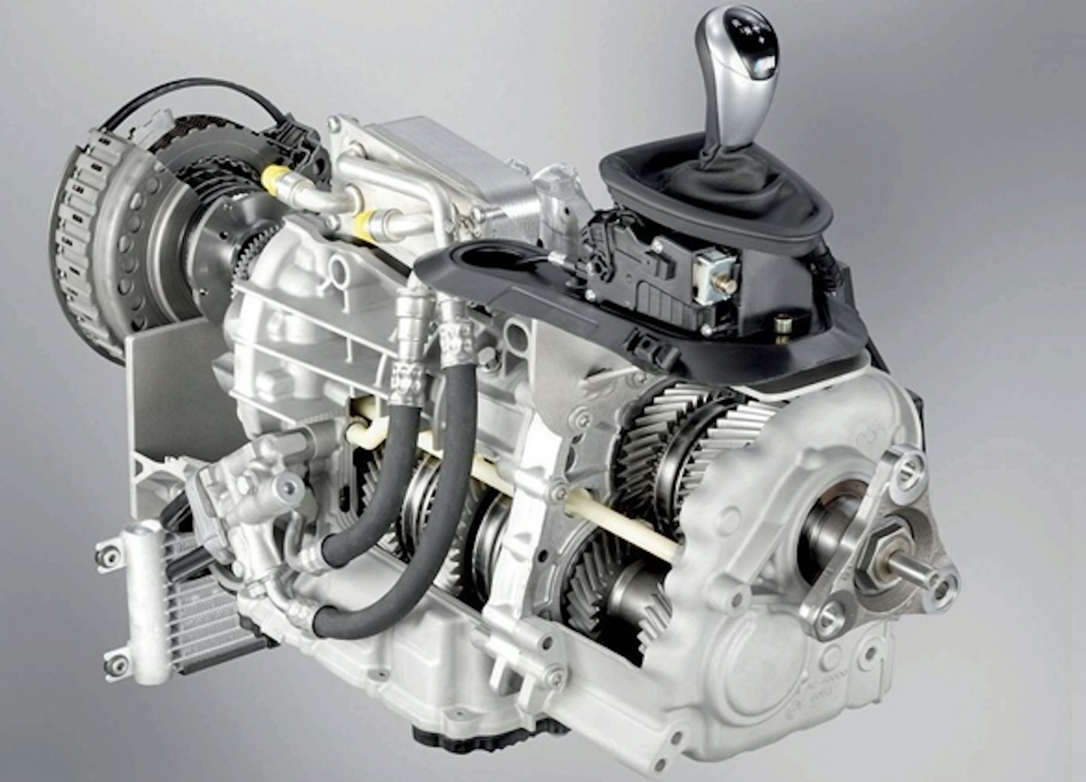
Why Storage Decoupling • Example
传统换挡杆和变速箱之间，机械式紧耦合
庞大的底层架构包袱

Slide 9
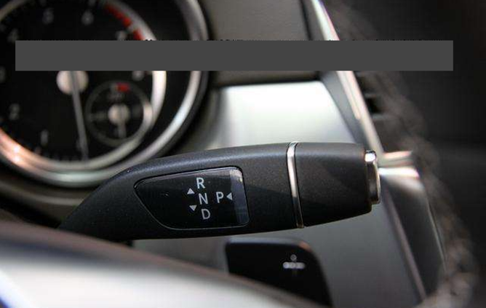
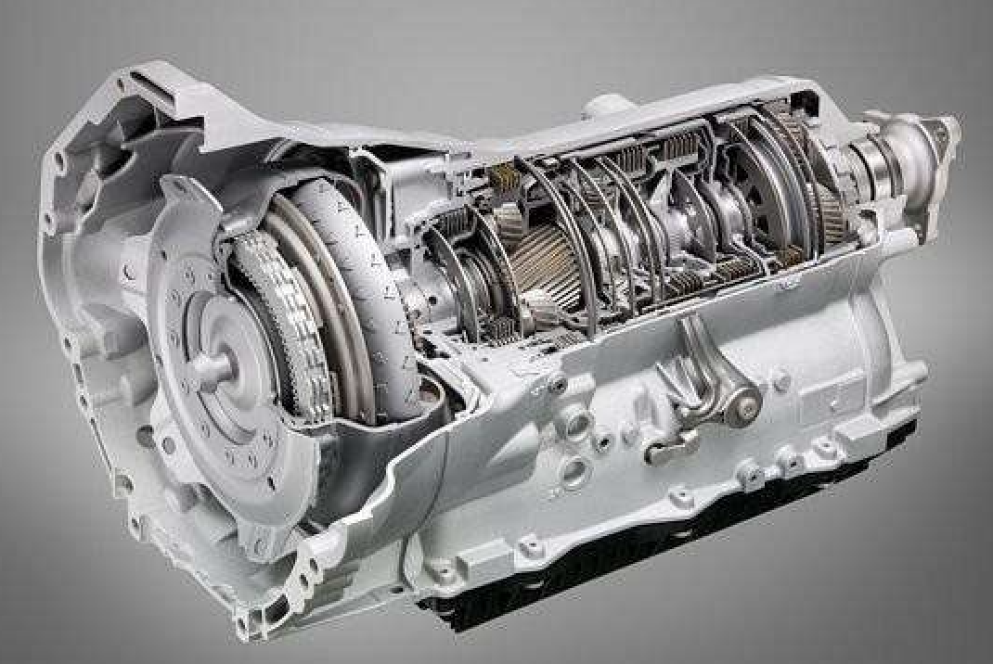
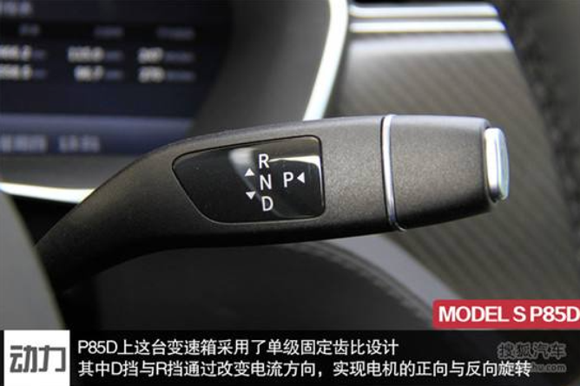
Why Storage Decoupling? To increase the coverage
Not only adapt to the traditional mechanical gearbox
Electronic automatic transmission unattached with Gear lever arm
Also fit to the electric car gearbox
Cross • Platform

Slide 10
Roadmap
eDR™
eMigration™
Integrated
Service Pack
Product
HyperMotion™
HybridDR
DRaaS
2017.12
2018.01 ~ 2018.06
2018.07 ~ 2018.11
2018.12
Service Management Platform
Technology Stacks
Data Transmission Optimization
Hyper Gate™
Auto
Driver
Fill-in
Adoptive Bandwidth
Adjustment
TecentCloud | AliCloud | AWS
vSAN | more Platform Storage

Slide 11
Speedway wide enough?
Yup! But empty
Cloud infrastructure computing trends
Global outbreak 2018 ~ 2020; Reshuffle stage 2020 ~ 2024,
Reach the peak 2024
DRaaS Demand outbreak
'Just the right time'

Slide 12
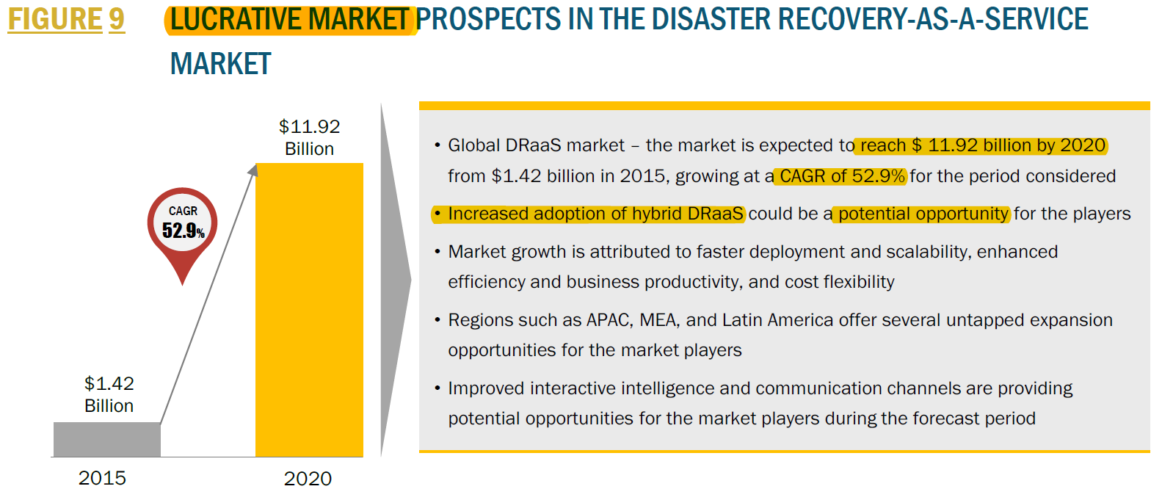
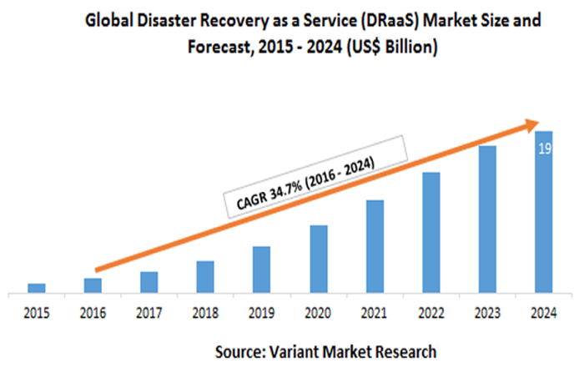
DRaaS Global Market Size
600B
Yr 2020
34%
CAGA

Slide 13
Prophetech
GO TO MARKAT STRATEGY
An Effective Market Entry Point
is more important than numbers of new skills and technologies
技术创新是拿来用到刀刃上
契合需求，创新才有价值

Slide 14
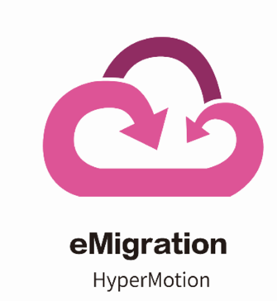














Seize the opportunity and align with Enterprise needs on Cloud Migration
Enterprise A
Enterprise B
Private Cloud
Private Cloud
Private
Cloud
Cross-platform [DR+migrate]
No Downtown
随上随下
Physical → Cloud
X
Restructure
Reinstall applications
Format conversion
Virtual ←→ Cloud
X
Local end → Cloud
Cloud → Local end
Reverse migration
Migrate btw cloud service providers
Private Cloud←→Public Cloud
X
Public Cloud ←→ Public Cloud
OpenStack | Vmware
KVM | Xen | Hyper-V

Slide 15



The core parties in the Ecosystem
Private Cloud Vendors
Cloud Project Integrators
Public Cloud Platform

Slide 16
Listen to the market!
Demand & Feedback
满足需求 才是硬理
用户买账 才是王道
行业认可 才是助力

Slide 17








DR vendors
IT vendors
System integrator
Channels
Enterprise users
“我们的灾备方案，在恢复的时候需要针对目标架构层层配置，金融客户，都在寻找一键(步)或者二步就能完成恢复的方案，但现在基本没有能真正实现的”
“如果博飞可以做到不需繁琐配置，一键就能在裸机上恢复，ECM愿意进行方案整合”
--EMC灾备方案规划部
“我们很早就上阿里云了，但随着业务多样化发展和信息管控需要，有些业务要从云上迁下来到本地（虚机或者私有云），有些业务要迁上去，但没有找到能随时方便迁移的方案，Xsky给我推荐了博飞迁移，评估能解决现有诉求”
--复星IT基础架构总监
“OpenStack的保护和恢复，我们在寻找好的解决方案，包括从传统架构恢复到云，以及云平台自身的容灾，希望能成为战略合作伙伴”
“跨架构的迁移，能解决我们在很多政企项目中的痛点”
--ZTE云计算及政企研发总工
“金山政务云托管在第三方IDC，希望在遭受攻击宕机时，能有另一个OpenStack云平台快速接管，保证业务不中断，持续提供服务，目前只有博飞云容灾方案能应对此需求”
“目前云容灾和迁移已经通过测试，我们希望尽快整合到Telstra-PBS的产品服务销售方案中，带来新增值业务”
--Telstra(PBS)高级产品经理
“裸机挂载，恢复到系统登陆界面，一键操作，这个非常吸引，目前我们做不到”
--Veeam灾备技术工程师
“在这个政务云项目中，原系统环境异构复杂，从物理机直接迁移到OpenStack云平台很难搞，遇到操作系统过旧或应用关联不清，就做不了迁移，对于整个迁移周期完全无法预测，博飞迁移很好解决了我们的痛苦”
--延华智能政务云项目总监
“我们目前没法针对上诉给出解决方案”
--华为云平台项目工程师
“云平台存储方案各异，迁移上云或者云上容灾如何能更好的适配所有存储技术，促进云存储资源的高效频繁使用，embrace cloud，embrace Ceph，博飞的HyperGate给了很好的助力”
--Ceph中国社区
“富士康提供第三方IDC服务，希望能有OpenStack云平台容灾接管方案，测试了Veritas、爱数、EMC都无法满足需求，博飞方案非常合适，目前已经完成测试，将尽快针对夏普生产系统进行容灾部署”
--Foxconn技术架构经理
“轻量软件产品，解除存储绑定，可以适用各类存储设备和云存储架构，整合到我们硬件存储产品中，（容灾/迁移）增值功能，不仅推进销售还能解决现有库存”
--Infortrend中国区总经理

Slide 18
有没有树立壁垒
Yup！ And Comprehensive
Technology、Time、Alliance、Channels
护城墙够高！护城河够宽！

Slide 19








竞争壁垒
Number of Patented Technologies
(Block-level protection/ Smart Adaptation/ HyperGate)
Cross-architecture, cross cloud platform
Recover in seconds
One-to-Many Protection & Recovery
Live Migration; near-zero impact on performance
China's first
Advance
Technology
Early started
海外有先驱经验借鉴
High
BARRIER
Many
Major Cloud Service providers
Major IDC Data Center
Cloud Computing companies
Hardware vendors
Deep
cooperation
Wide
Channels
Traditional IT Channels
System integrators by Industry, by region
Direct relationship in key industries
[Founding team]
Time + Technology + Scale + Ecology
一个起跑线定输赢的市场、一个只有第1名没有第2名的市场
PropheTech is in the right spot at the right time
China
NOW
foreign

Slide 20
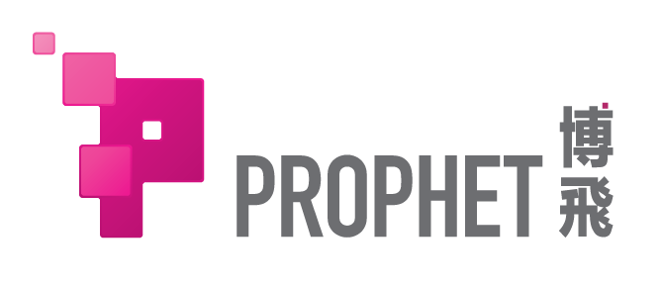


Major competitor (technology-wise)
Establishment | Yr 2016 | Yr 2012
Registered Region | China (Shanghai) | Israel
Business positioning | Cross-platform cloud disaster recovery, migration,Openstack Cloud Architecture | Cross-platform cloud disaster recovery, migration
Financial status | Angel Fund RMB 500 raised [Yr 2017] [20 people] [Team expansion, product optimization] | Series B USD 1.3M raised [Yr 2015] [20 people] [Team expansion] Total: USA 1.820M
Platforms compatibility | OpenStack | Vmware | KVM AWS [China] Ali Cloud | Tencent Cloud | Ksyun | Ucloud [China] IT segment by industry by region | Vmware | KVM AWS | Windows Azure | Google cloud [China] none
Protection ratio | 1:20 (One-to-Many, lowering TCO) | Unknown (Demo evaluation)
Migration | 旁路容灾恢复技术 [Live Migration] | Live Migration CDP Technology [Live Migration]

Slide 21
Product Ready?
Absolully!
[Disaster Recovery]
eDRTM
Standard Software
cloudDRTM
Disaster recovery cloud platform
[Migrate]
eMigrationTM
Standard Softwar
+
service

Slide 22










Product & Service
How
Market pitching
System Protection + Integrated Recovery Machine
以数据备份的价格实现业务级容灾
(低级) (高级)
Sales model: Via channels
eDRTM
DR+KVM/ VMware/ Physical machine
Public
Cloud B
Public
Cloud C
Online
Cluster System Protection + Integrated Private cloud recovery platform
Extending the DR advantage to the cloud platform, Run DR under different environments, improve efficiency
Sales model: Integrated solutions for channels
Public
Cloud A
cloudDRTM
DRaaS
Private Cloud
OpenStack
DR + OpenStack
cloudDRTM
eMigrationTM
Lightweight Cloud Deployment
Monthly/ Quarterly/ Annual subscription
Sales model: Via public cloud service provider and IDC vendors
DRaaS
Offline
DR + Various public cloud
business system
eDR TM
KVM
Vmware
Physical machine
Utilize disaster recovery technology and develop innovative migration solution
Cloud Deployment Tool; charge by service
Sales Method: Standard Service
eMigrationTM
eMigration + variety platforms

Slide 23












Disaster Recovery DR
Core features
Cross platform [DR+Migrate]
Recover in seconds
Full-stack
One-click recovery
One-to-Many protection
Local storage ←→ cloud
Ensure business continuity
30 to 90seconds recover to the specified platform
System+Application+Data Recovery
Protection+Integrated recovery machine
protection:Block level (patent)
恢复:全对象挂载
Deployment of layers is not required
One-click operation
Customize DR strategies plan
Rehearsal anytime, near-zero impact to business
1 eDR protects 15 systems
Max. protected capacity 80T
Reduce DR cost by 85%
Private Cloud ←→ Public cloud
Public cloud ←→ Public cloud
OpenStack | Vmware | KVM |
AWX | Azure | Ali Cloud |
Tencent cloud | Other public cloud

Slide 24


eMigration
Core features
No Downtime
Across any platform [Disaster Recovery+migrate]
随上随下
A key migration
Verifiable / 回滚
旁路设计迁移
Without interrupting production
Physical → Cloud
Local storage → Cloud
Cloud → Local storage
可回迁/可转迁
无需层层部署
One-click migration
System+Application+Data
migration
迁移结果可测试/验证
有问题可随时回滚
Zero risk migration
Virtual ←→ Cloud
Private Cloud ←→ Public Cloud
Public Cloud ←→ Public Cloud
OpenStack | Vmware
KVM | Xen | Hyper-V

Slide 25
Profit Planning?
Yup! Well-planned
地域、行业、产品多维度规划
脚踏实地去做
梦想才会照进现实

Slide 26











Operation Model
eMigration
Cloud DR
Commercialized Product
Service
Cloud
Enterprise
Public Cloud
Cloud Market
System
Integrator
Cloud Technology
Vendor
Integrate projects
Gov.
Industry
[Medical/energy/
traffic]
生态合作
Project referral
State-owned enterprises
Financial Institutions
Third Party IDC
Industry
Benchmark
行业复制
扩散
Provinces
Rural Credit Union
Listed Commercial
bank
IDC
Value-added services
Subsidiary
SME

Slide 27
Sales Structure
Gov/Gov owned
Enterprise
Cloud
Service Provider
IT Integrator
HW vendor
Large Enterprise
Financial
Private Cloud
(OpenStackplatform)
Private Cloud
(Standard integrated machine)
eMigration
eMigration
Cloud migration
Product
eMigration
eDR
cloudDR
cloudDR
cloudDR
eDR
cloudDR
Branding
淬炼产品
Branding
Expand
Profit
Branding
Ecosystem
Profit
Industry influencers
Profit
Expand coverage
Branding
行业辐射
Profit
Purpose
Project
Project
Profit Sharing
Agent
Integrator
Commercialized Products
Service
Mode
Target
Customer
城商/农商行
(一、二级法人)
（全国约2300家，独立采购权）
地级市政府
（全国约300个）
Public cloud service providers
Large Third-party IDC
IT Integrators
Server/Storage hardware vendors
Large Enterprise
Jiangsu Rural Credit Union (Grade I)
沭阳农商行 (Grade II)
Bank of Nanjing
Jingzhou City (地级市)
贵州金阳县（县级）
上海市吴泾第二电厂
Shanghai the 6th People's Hospital
Unissoft, Chinaforwards, Rainbowtech
AWS, AliCloud, Ksyun
ZTE
Fosun Group
Shenergy Group
Status
GDS/ PBS/ Foxconn/Travelsky
Infortrend/AMD

Slide 28
Revenue Planning
33.7B
¥
China + overseas
Forecasting RMB 33.7B by the end of Yr2020
DRaaS
[China+APAC]
ProphetCloud
eMigration
eDR
Yr 2020
22.5B
2.0
4.5
4
12
Yr 2019
10.3B
1.5
2
1.8
5
Yr 2018
0.15
0.85B
0.5
0.2
5
1
Yr 2017
1
7B

Slide 29
Profit Model
eDR Integrated Machine
[Commercialized]
$10K
N / A
CloudDR /
eMigration
[1:15 protection]
cloudDR
[Solution implementation]
$30K
20%
[Est.]
Cloud platform
service charge
Development
Infrastructure
expansion
[SMEs mean]
eMigrate
[service / Solution]
$10K
N / A
[SMEs mean]
Development Cost
Annual Service Charge
Cloud Integrated Machine
[Commercialized]
$150K
30%
[Est.]
[3Nodes small company]
Cloud platform
service charge
Development
Infrastructure
expansion
[Including hardware]
Cloud
Platform
Private cloud deployment
[Customized solutions+Implement]
$250K
30%
[Est.]
Cloud platform
service charge
Development
Infrastructure
expansion
[1 time / Incl.HW]
专有云 适配开发
[适配方案/产品定制开发]
$150K
15%
[Est.]
[1 time]
Module subscription fee

Slide 30
Is the team ready?
Yup! And they are Unique & Outstanding
我们不是菜鸟，不会拿一个idea就来画饼
需求驱动技术创新
营销推动技术变现
团队支撑梦想实现

Slide 31
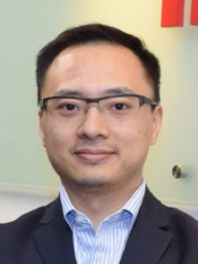
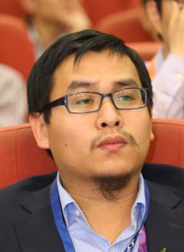

Founding Team Member
Michael Wong
Ray Sun
Angela Wang
Founder CEO
Co-founder CTO
Co-founder CMO
Market & Product Positioning
Business Development
Customer Relations
Research & Development
Project Deployment
Frontier Technology Research
Go-to-Market Strategy
Business Management Public Relations
Imation [NYSE:IMN]
General Manager - Greater China
Motorola
CIeNET Technologies
Huron Technology Co-founder & CTO
OpenStack Trainer
Ceph Community Leader - China
Global Telecommunication Companies
Asia-Pacific Marketing Director
MTO Project Director - Europe
Senior Strategic Planner
11年中国市场拓展、销售及运营经验
擅长创新商业模式
技术与市场间的重要桥梁
知名外企前瞻科技研究
参与工信部、开源云联盟相关产业标准化及标准制定
10年市场营销、项目操盘、规划策略经验
擅长行业洞察、机会挖掘，资源整合
工科背景，营销思维

Slide 32
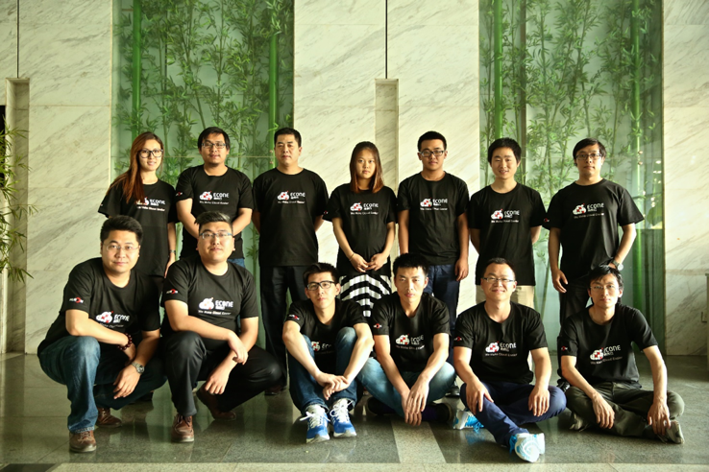
R&D Team
Principal CTO
中国首批OpenStack云计算研发及产品化的实践者
OpenStack、Ceph 开源技术布道者及资深培训师
开源社区影响力人物
在云计算领域有丰富人脉关系
与英特尔、思科等企业有优质合作关系
Core Members
中国首批OpenStack云计算研发及产品化的实践者
OpenStack、Ceph 开源技术布道者及资深培训师
开源社区影响力人物
在云计算领域有丰富人脉关系
与英特尔、思科等企业有优质合作关系
Ingenuity Persist Focus
◇
◇

Slide 34








Innovative Technology
P → C
Physics → Virtual
Virtual → Cloud → Clouds
Physical machine
VM
VM
VM
Virtualization
Cloud Computing
Assets cure
Virtualized Asset
资产无形 自由流转
平台更换 资产迁移
X86
KVM
Xen
KVM
技术升级迭代
目标功能实现
短期资源爆发
Risk Control
成本优化
Power
HyperV
KVM
KVM
Offline + Online
Prophet DR/Migration
Innovative Technology
任意平台 全栈式方案
eDR

Slide 35
Technical Explanation & Reference

Slide 36

Technical Framework
DR & Migration Highlights：
块级别保护，保护为全对象:操作系统+应用+应用配置+数据，成为实现整体恢复的前提
RPO分钟级，RTO秒级，
无须昂贵的硬件，成本低，保护高效，
旁路设计不影响生产业务
针对不同的虚拟化平台、云平台进行了接口层面、虚拟化智能适配，业务系统不同平台恢复成功率>95%
恢复计划，满足集群恢复时启动顺序的依赖关系
迁移上使用HyperGate*控制器，为云存储增加虚拟机的“机头”，可以适配所有云平台，无须特殊存储接口要求
Protection
Abstraction layer
Recovery
Abstraction layer
Migration
Public Cloud
C
Private Cloud
Public Cloud
Public Cloud
B
Public Cloud A
restore
Asynchronously
business system
虚拟化硬件驱动适配层
直接写入云端块存储
虚拟化/云平台接口适配层
Storage+Technology Highlight：
通过抽象存储+层完成DR层与存储层的解耦
能够支持70多种不同品牌和型号的商业化存储进行管理和作为DR后端使用
解耦存储层后，让云端灾备和云端迁移成为可能性
Agent
虚拟化接口
恢复计划(调度与编排)
HyperGate*
Storage +
Storage Management
Resources Management
卷管理
卷组管理
远程复制
......
Core Technologies (Exclusive)
块级保护（实现应用级秒级恢复）
智能驱动适配（实现跨任意平台）
HyperGate（实现适配任意云存储）
Software-defined storage
ZFS
Software-defined storage
Ceph
Traditional storage
FCSAN
Cloud
Storage
Storage
on Cloud
...

Slide 37



核心技术解读
Protection level
Application layer
File system layer
支持性差
受限于文件系统
Inefficient
全量重复保护
Existing DR vendors
Eisoo, info2soft,Veeam
块设备层
支持性好
不受限于文件系统
Efficient
变量/增量保护
唯一：国内自主研发技术
Prophet FalconStor
首创： 智能驱动适配层
全栈式保护
高速恢复的基础
Hardware layer
Hardware layer
虚拟设备层
云平台层
首创 : HyperGate
实现任意云存储资源对接
Live
Double Live
Prophet
Prophet

Slide 38



Change Demand Fulfillment
◇
容灾=Protection+Restore
灾备=Backup
Recovery
Operations
Recovery
Time
Platform
Requirements
Production
Restore
Install operating system
Application config
Install applications
Database config
Network config
Import Data
Restart
Login
Primary
machine
30mins~1day ~...
备机需与源机同架构
备机
or
或
源机→备机 多次驱动转换
[File-level]
Data copy
[Data level]
data import
Traditional
Restore failure
Protection
Backup
[Block-level]
system+App+data
Snapshot
[Application-level]
全对象镜像挂载
One-click Recovery
Login
30 - 90second
备机可为任意架构/平台
Primary
machine
备机
* Prophet Patent *
[驱动智能适配]
Physical | Virtual | Cloud
X86 / VMware / KVM / Xen / Hyper-V
Protection Level
Different
Backup objects
Different
Recovery Level
Different
Everything is changing

Slide 39








Change User experience
◇
方案选择
云计算应对
Protection
Restore
Production
Backup/DR
Complex Environment
Hybrid Architecture
?
A disaster recovery plan needs A+B+C+D
?
?
Unable to migrate directly from physical machine to cloud
Different architecture requires different DR plan
Solution A
Solution C
?
?
Architecture B
Solution B
Solution D
每个方案绑定存储介质(硬件)
Architecture A
Unable to utilize cloud platform resources (Inexpensive/elasticity)
方案厂商技术依赖
Architecture C
Traditional solution vendors are incapable to provide solution
Protection
无法自由选择、适配各个不同云平台
Architecture D
仅需 一个方案
实现跨架构 保护→恢复
any to any
适配不同架构、不同云平台
自由选择、按需使用
Prophet DR
Any Architecture
Any Platform
科技红利 省心、省钱、省力
Business continuity
畅享云计算弹性优质资源
无需购买多种方案
无需厂商硬件绑定
无需头痛技术人员培养
容灾资源复用增值
User review

Slide 40
是不是刚需
是！ 且蓝海
很久以前，没有云，没人在意迁移；
很长时间，只有灾备，容灾不是标配！
现在，云计算迅速普及，各行各业全面上云
怎么上？怎么下？→迁移
怎么保障业务连续？→容灾

Slide 41
？做灾备的不懂云
？做云的不懂灾备
？想要容灾却只用得起灾备
？做私有云的不懂公有云
？做公有云的不理私有云
？每朵云之间互立门槛
Prophet DR
把云上容灾做成标配的先锋！
Prophet Migration
搭起云之间桥梁，自由流转！
智能手机之于3G
微信之于智能手机
博飞之于云计算
技术革新，机遇刷新，还是蓝色的海

Slide 42

DR Classes
$cost
Backup = Disaster Recovery
Expensive
双活
IBM
EMC
Three major classes of Backup/DR (Low to high)
I.Data level II.System level III.Business Class
前两级侧重保护，对象侧重数据，对于恢复解决较弱
业务保护最高级别需要做到业务连续实时在线可用只有架构‘双活’能实现
FalconStor
Commvault
Class
Acronis
Rorke
Veritas
Veeam
atpchina
Traditional Backup Competition： 围绕存储展开（容量/速度/成本），针对备份(backup）
互联网时代容灾竞争：Recovery speed、Business Continuity、Flexibility、Cost Effectiveness
EISOO
Suctech
Storage
vendors
烽火
Competition
Prophet DR
Inexpensive
SLA
DR classes
传统经济时代，IT系统更多服务于企业内部，因此对于业务连续性要求不高
互联网+时代，IT系统之间面对用户，业务中断直接带来的巨额经济损失
业务级容灾、高速恢复、业务连续 需求爆发，时机已至！
low
medium
high
Driving force
Data-level DR
System-level DR
Business-class DR
Data
System+Data
System+App+Data
Protection
Protection+Restore
Complete protection+Speedy recovery

Slide 43
Applicable platform comparison
Multi-platform
RTO (Long time business recovery) |  | 30-90s | > 30mins | > 30mins | > 1hr | > 15mins | ≈30mins | ≈30mins
Cross-platform DR |  | Prophet DR | IBM | EMC | Veritas | Veeam | EISOO | FalconStor/Number of Teng/Boke
Public cloud | Amazon AWS | ✔
 | Microsoft Azure | 4 |  |  |  | ✔
 | AliCloud | ✔
 | Tencent Cloud | 4
 | Ucloud | ✔
 | Ksyun | ✔
 | Other 3rd Party cloud | Continued to increase
Private Cloud | OpenStack | ✔ |  |  | ✔
Virtual Platform | VMware | ✔ | ✔ | ✔ | ✔ | ✔ | ✔ | ✔
 | KVM | ✔
Physical system | Physical machine | ✔ | ✔ | ✔ | ✔ | ✔ | ✔ | ✔
Cloud Era，不能支持云平台
容灾的坑谁来填？
跨平台恢复亟待解决
云计算让资源变得无限量、高效、灵活、按需弹性。
为什么科技带来的红利没有在容灾体现？
Technology
意识
还将容灾视作“可有可无”“冗余负担”？
生产系统懂得用云资源，为什么容灾不用？
意识的缺乏，博飞来唤醒！
Firm

